Slide 1
Systems Analysis and Design CT026-3-1
System Development Life Cycle

Slide 2
Topic & Structure of The Lesson
Explain each of the SDLC phases briefly
Define Systems Development Methodology
Explain the importance of Systems Development Methodology

Slide 3
Learning Outcomes
By the end of this module, YOU should be able to address:
System Development Life Cycle
Overview of SDLC
Phases in SDLC

Slide 4
Key terms you must be able to use
If you have mastered this topic, you should be able to use the following terms correctly in your assignments and exams:
Systems Development Life Cycle
Systems Development Methodology

Slide 5
Introduction to SDLC
Software crisis – systems delivered were
late
over budget
unreliable
difficult to maintain
did not do what was required
System development life cycle - an attempt to establish structured approach to systems analysis and design
Notes:
(1:10) – indicates that to return to previous phase would cost 10 times more expenses

Slide 6
Introduction to SDLC
Structured Analysis
Traditional system development techniques that is time-tested and easy to understand
Uses phases called the systems development life cycle (SDLC)
Uses process models to describe a system graphically

Slide 7
Systems Development Life Cycle
Also known as applications development cycle
an organized approach used in organizations to develop an information system
traditional methodology
normally used on large projects
require extensive development periods more than 1 year
complicated
results do not always satisfy the user
expensive approach considering the money, time and effort put in

Slide 8
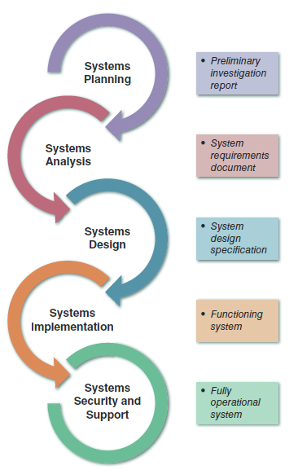
Overview of SDLC phases
The SDLC model usually includes five steps
Systems Planning
Systems Analysis
Systems Design
Systems Implementation
Systems Security and Support
FIGURE 1-25 Development phases and deliverables are shown in the waterfall model. The circular symbols indicate interaction among the phases.

Slide 9
Phases in SDLC
Systems Planning
Begins the process with system request which describes problems or desired changes in an IS or a business process
Purpose of this phase is to perform a preliminary investigation to evaluate an IT related business opportunity and problem
Preliminary investigation is a critical step because the outcome will affect the entire development process
Deliverable is preliminary investigation report

Slide 10
Phases in SDLC
Systems Analysis
The purpose is to build a logical model of the new system
By creating requirement modelling which to investigating business processes and document new system
Perform fact-finding techniques such as interview, survey
Deliverable is the system requirements document

Slide 11
Phases in SDLC
Systems Design
Create a physical model that satisfies all documented requirements for the system
Design user interface
Identify outputs, inputs, and processes
Deliverable is the system design specification
Management and user involvement is critical

Slide 12
Phases in SDLC
Systems Implementation
New system is constructed
Programs are written, tested and documented
System is installed
Deliverable is a completely functioning and documented information system

Slide 13
Phases in SDLC
Systems Security and Support
A well-designed system must be secure, reliable, maintainable, and scalable
Most information systems need to be updated significantly or replaced after several years of operation

Slide 14
Systems Development Methodology
Definition
A standard process followed in an organization to conduct all the steps necessary to analyze, design, implement & maintain IS

Slide 15
Systems Development Methodology
Importance
To ensure consistency in management of projects
To ensure easier estimation of project times and costs
To eliminate those causes of unsuccessful system development – e.g. a more understandable process
Reduce time & cost

Slide 16
Systems Development Methodology
Importance
Interact & encourage user involvement
To improve the quality of work & system
Produce complete & accurate design specification and documentation
Meet user requirement

Slide 17
Quick Review Question
What does SDLC stands for?
What are the main phases in SDLS?

Slide 18
Summary of Main Teaching Points
Overview of SDLC (Systems Development Life Cycle)
Overview of phases in SDLC
Systems development methodology

Slide 19
Question and Answer Session
Q & A

Slide 20
What we will cover next
Planning
Problem Statement
System Change Request
Preliminary Investigation

Slide 21
References
Essential Reading
• Satzinger,J.W., Jackson,R.B., Burd,S.D. (2016). Systems Analysis and Design in a Changing World. 7th ed. Cengage Learning. ISBN: 1305117204 • Valacich,J.A., George,J. (2016). Modern Systems Analysis and Design. 8th ed. Pearson. ISBN: 0134204921
Suggested Reading
• Schwalbe,K. (2016). Information technology project management. 8th ed. Course Technology. ISBN: 9781285452340

